Slide 1
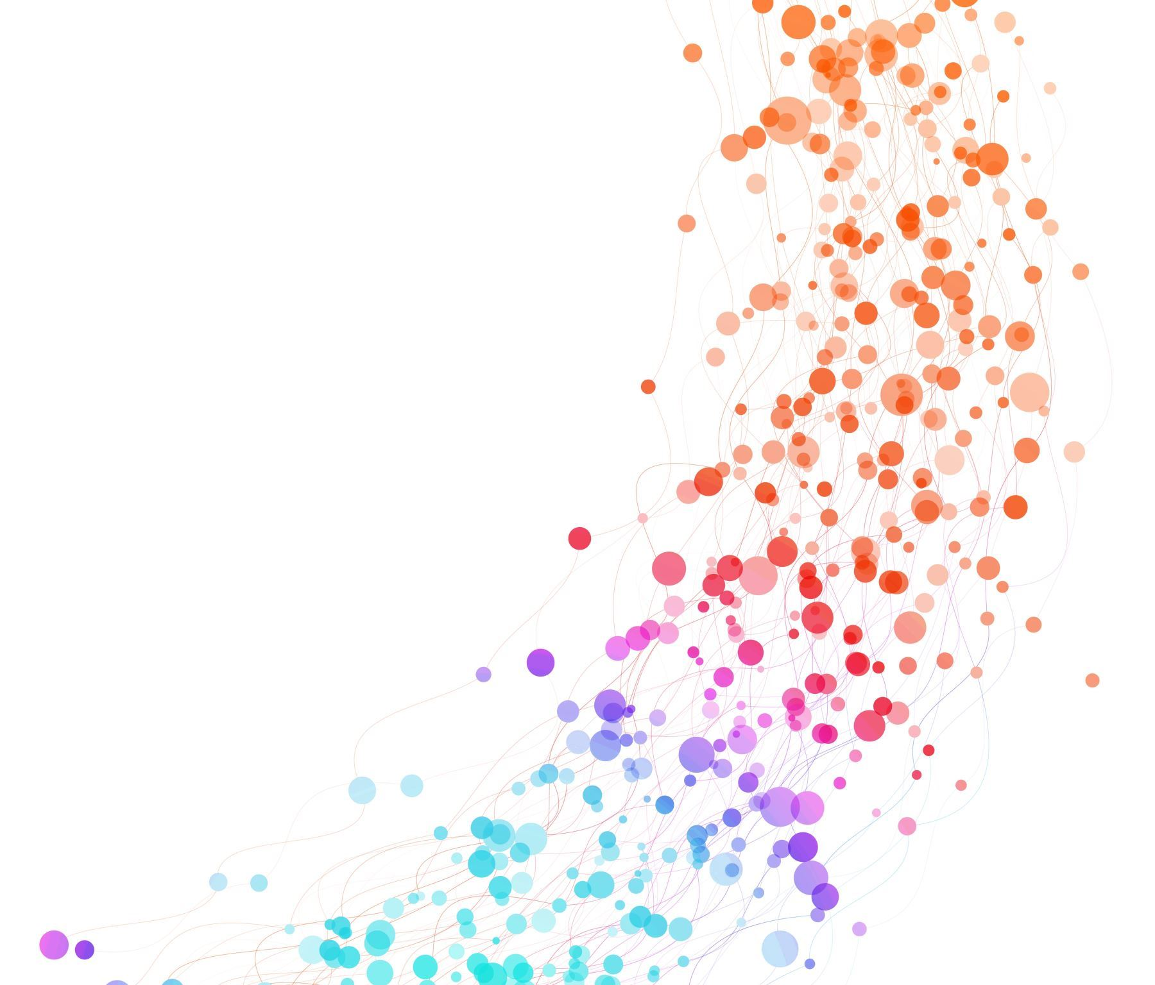
HERE's HACATHON IITB - Team 5G Only

Slide 2

HERE's Hacathon
UrbanMate: Revolutionizing Urban Planning with Geospatial Analytics

Slide 3

Introduction
The problem statement
Emphasize the importance of leveraging geospatial analytics for urban planning

Slide 4

Problem Statement
Highlight the challenges faced by city planners
Emphasize the need for real-time geospatial analytics in urban planning

Slide 5

Solution Overview

Slide 6
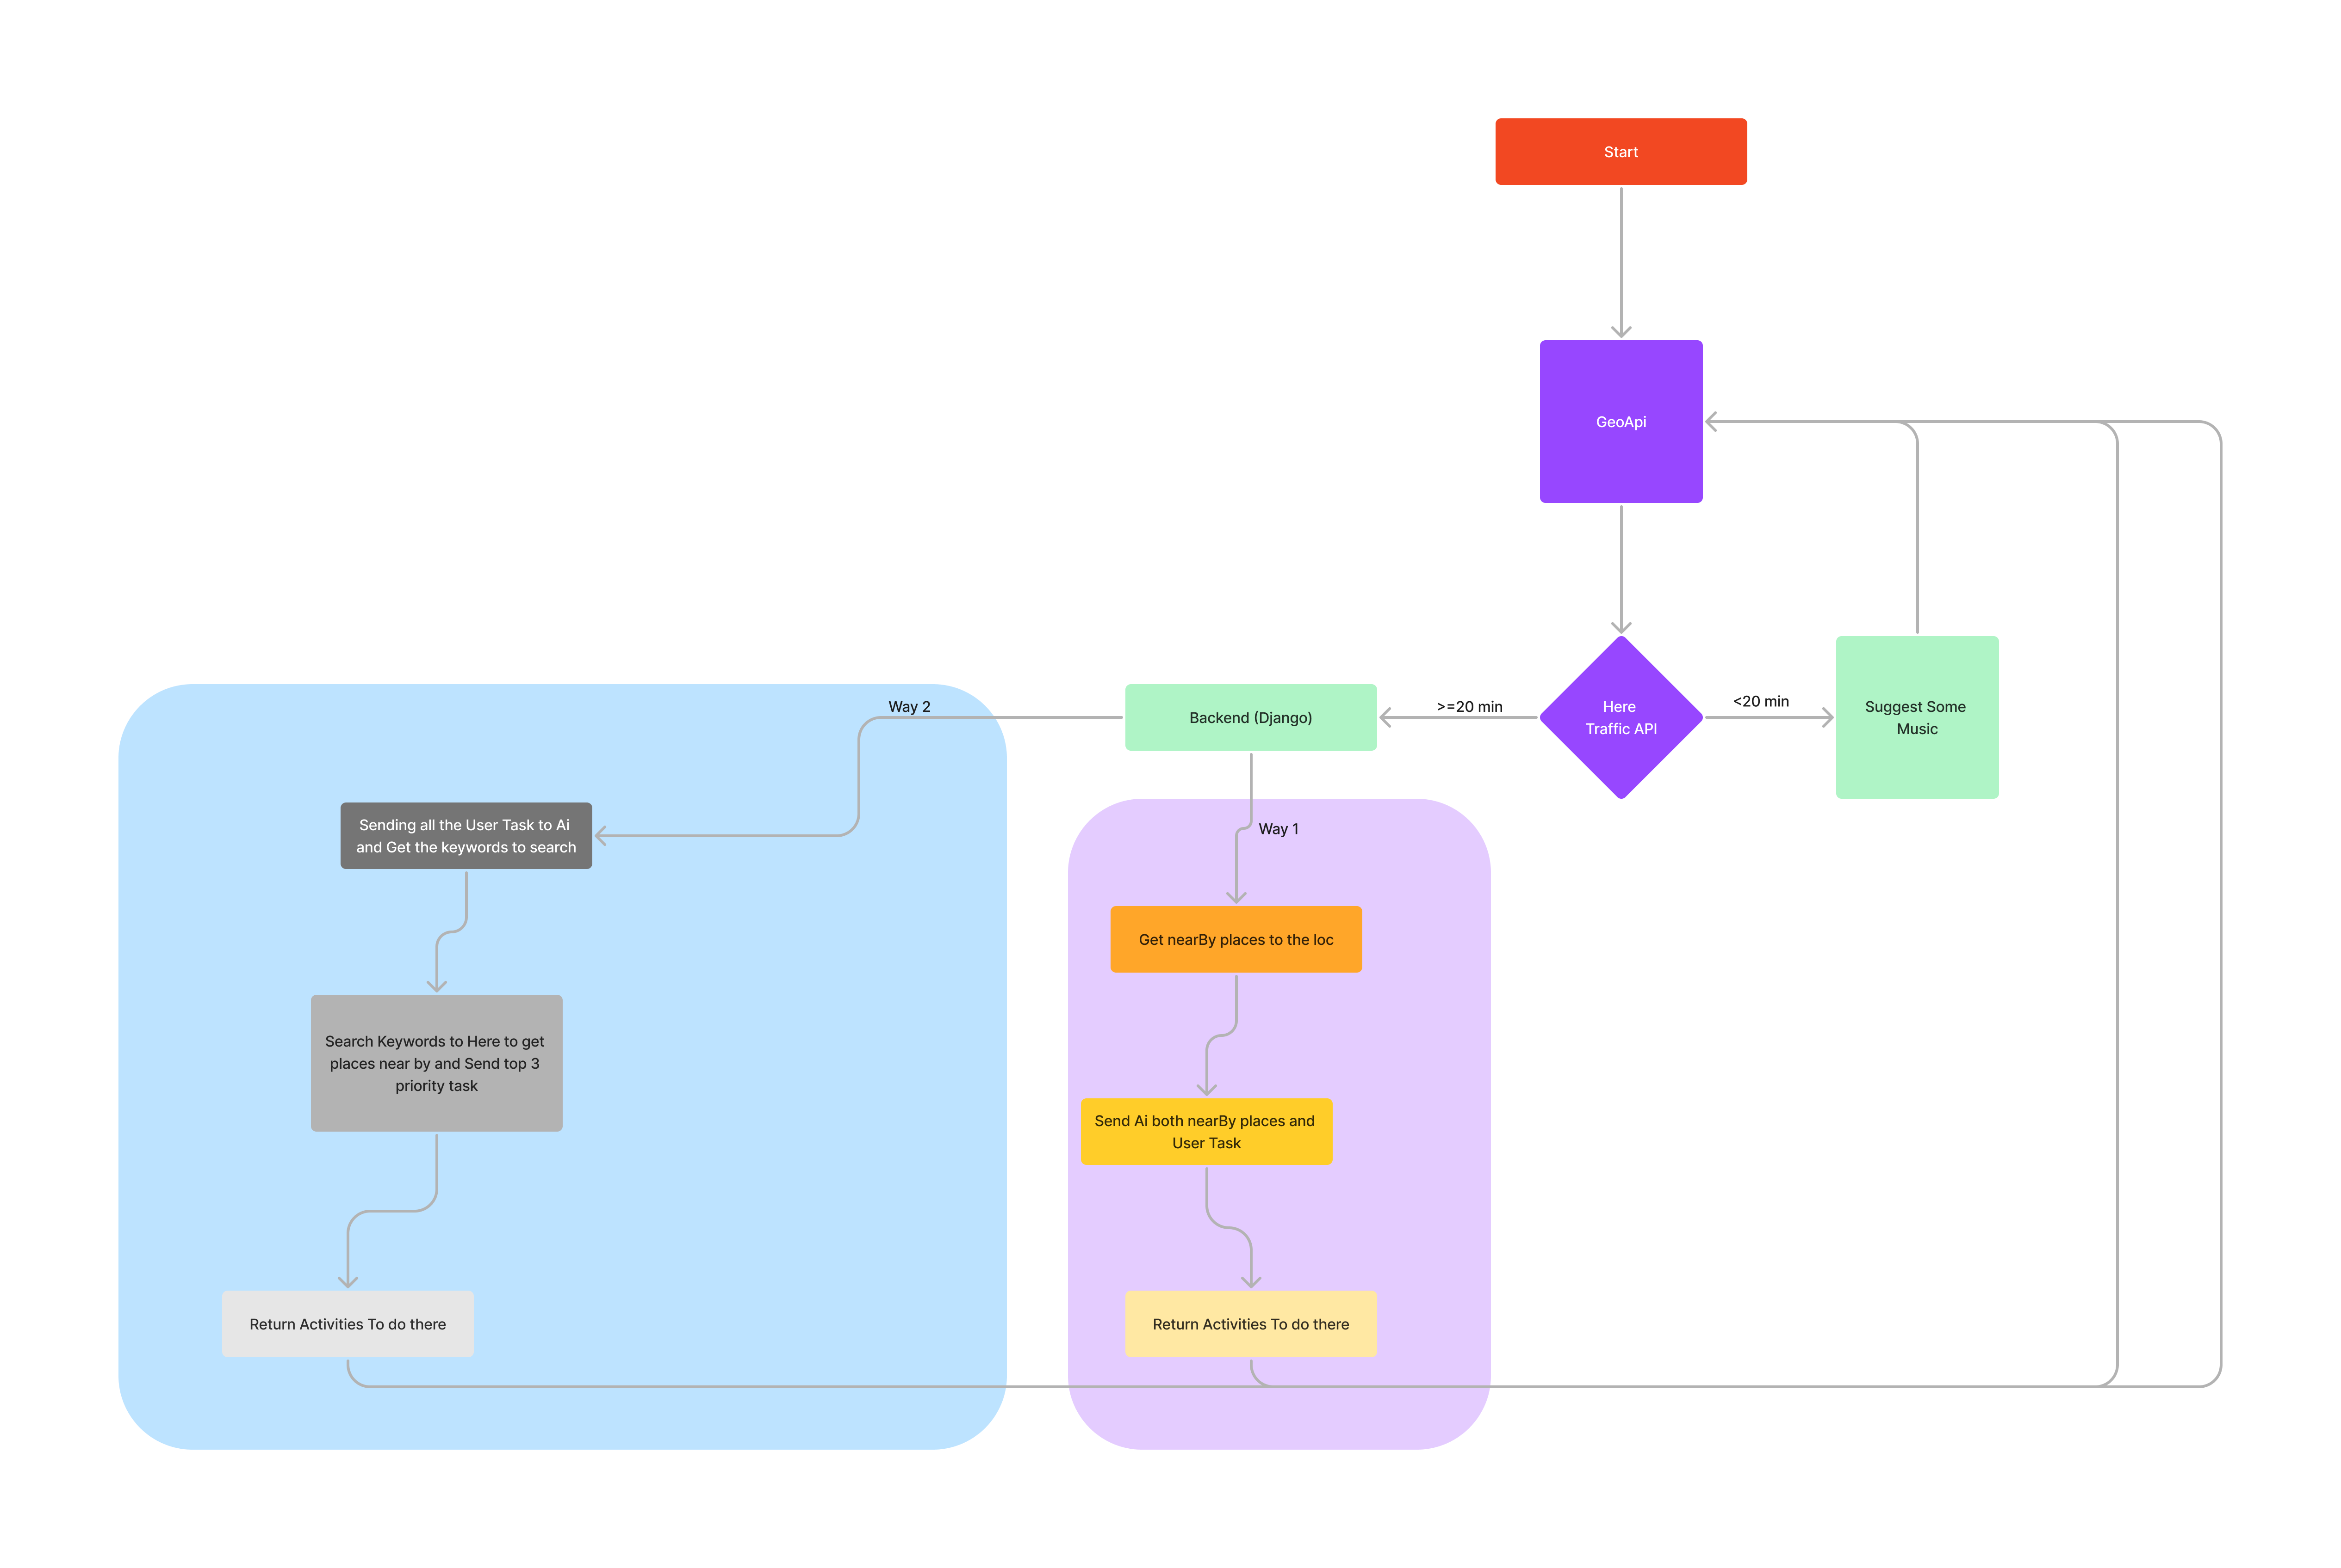
High-Level Flow Diagram

Slide 7

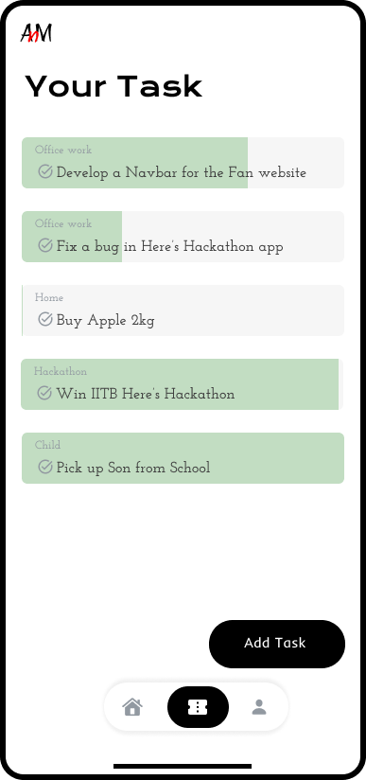
Task Management
Emphasize the user-friendly design and ease of use

Slide 8

Location-Based Traffic Analysis
HERE's Traffic API

Slide 9

HERE's Technologies
HERE's Place Search API and HERE's Map.
Easy and simple experience.

Slide 10

Technology Stack
Technologies used in our solution
HERE's Place Search API
HERE's Map
Django
OpenAI
Flutter

Slide 11

Business Model Overview
Local Advertiser's
Suggesting Show(Advertisement)

Slide 12
Revenue Streams
Subscription model for advanced features
Potential revenue from partnerships with local businesses

Slide 13

Local Places and Events
Integration of local places and events for additional revenue
This enhances the user experience with relevant recommendations

Slide 14
12: Real-Time Application
Our app addresses real-time challenges in urban planning
The benefits of dynamic task management and traffic prediction

Slide 15

13: Market Opportunity
No Competiton

Slide 16

Market Research
Include key findings from your market research
Highlight the growing need for urban planning solutions

Slide 17

14: Team Members
Team members: Himansh Raj and Alok Moond

Slide 18
15: Q&A
Time for question...

